Slide 1

Spotify Tracks
Project of Big Data Computing
Sapienza University of Rome
Department of Computer Science
Professor: Gabriele Tolomei
Students:
Andrea Bernini - 2021867
Donato Francesco Pio Stanco - 2027523

Slide 2
Project Overview
Preliminary Steps:
Data Exploration
Preprocessing
Split the dataset
Encoding
Supervised Learning:
Classification
Regression
Used Spotify Dev API to create our own dataset
Recommender
System

Slide 3

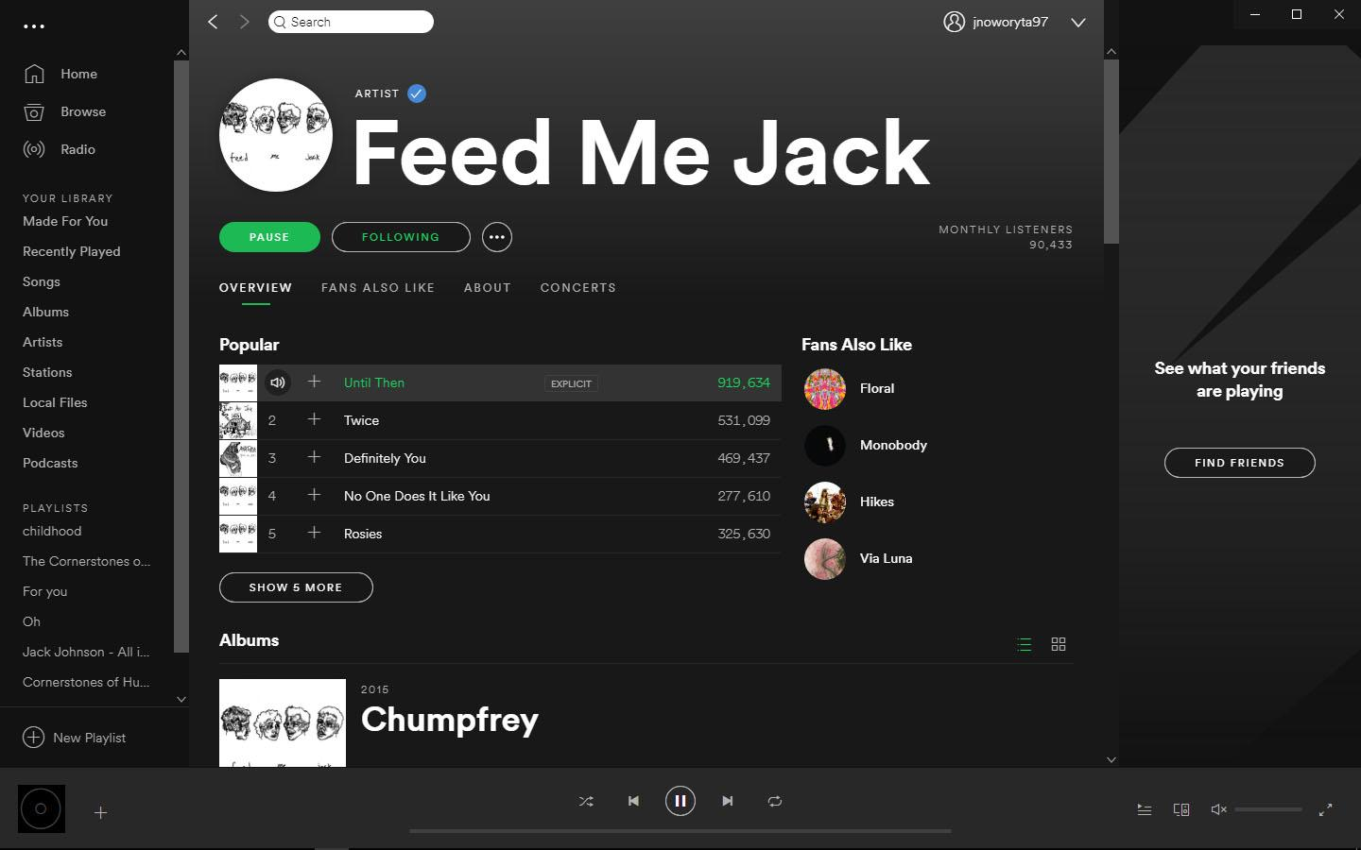

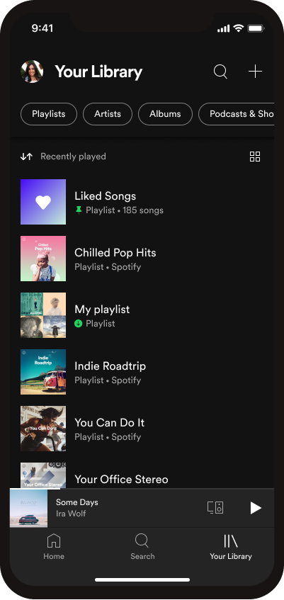
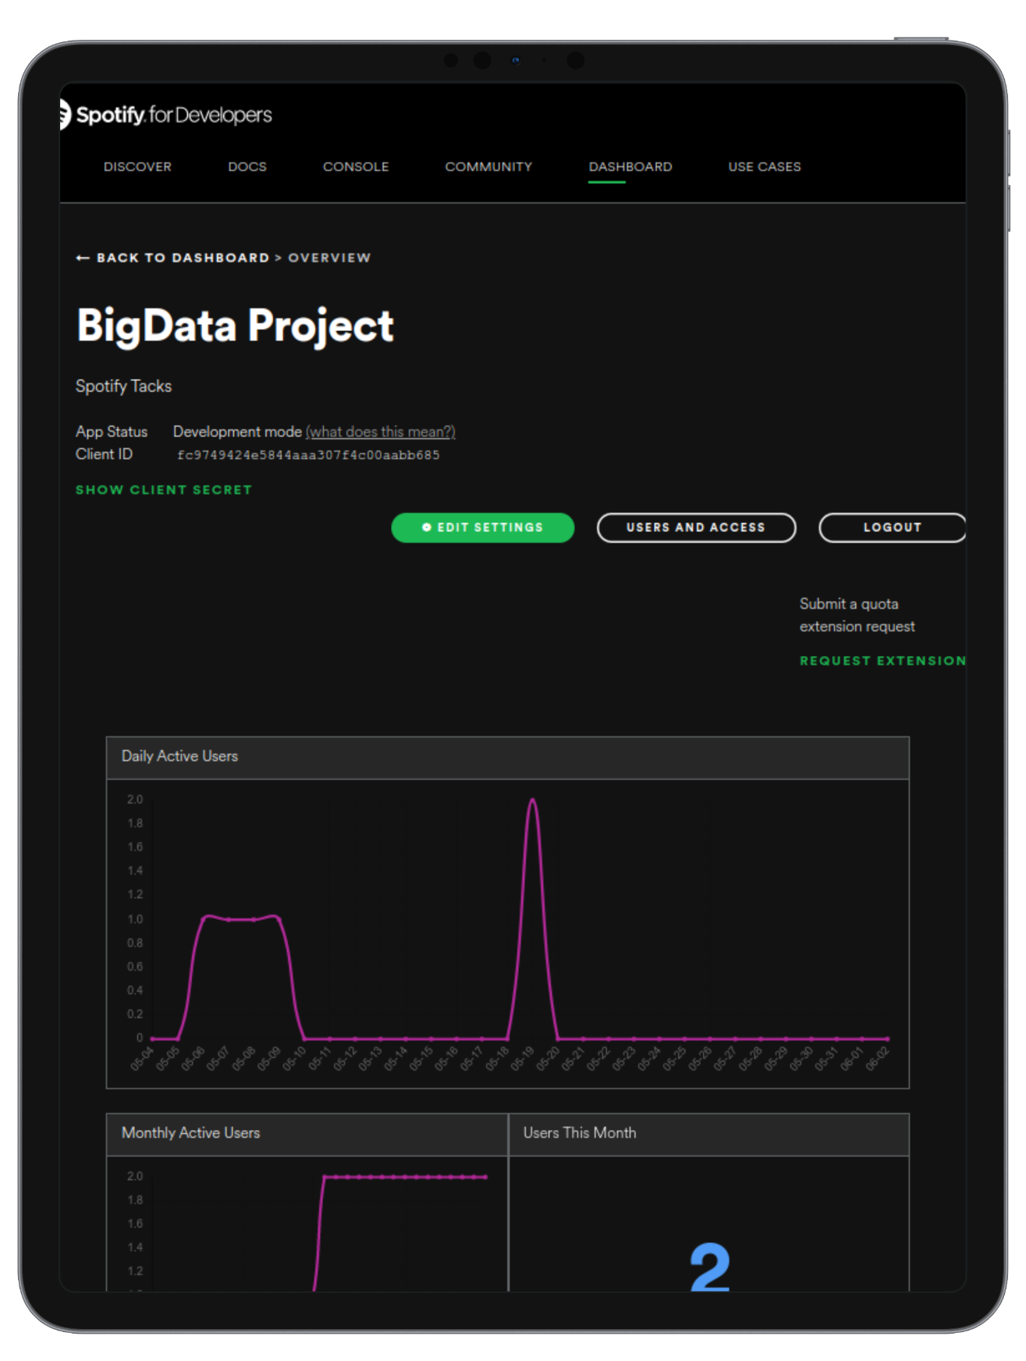

Data Acquisition: Spotify
Today Spotify is one of the most popular app for listening music (online & offline).
It counts around 1 billion of installations (reached in 2021 on Play Store).
In order to create our dataset we used the Spotify Dev API and a Python Program that makes request to the Spotify Server.

Slide 4
Data Acquisition
For data acquisition first we look for a dataset that has the genre associated with the song.
After several searches we have not found an adequate dataset.
The Reason:
Spotify does not associate the genre directly with the track but exclusively with the artists;
An artist in most cases has multiple genres.
Therefore we decided to create a dataset from scratch using the Spotify Web API.

Slide 5
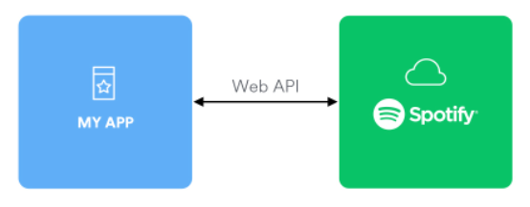
Data Acquisition
The Spotify Web API provides queries to get:
the list of all genres classified by Spotify;
a list of up to 100 recommended songs given a specific genre;
the audio characteristics of a track given its Spotify ID;
the playlists of the user given his Spotify ID.
We used these to create the two datasets

Slide 6
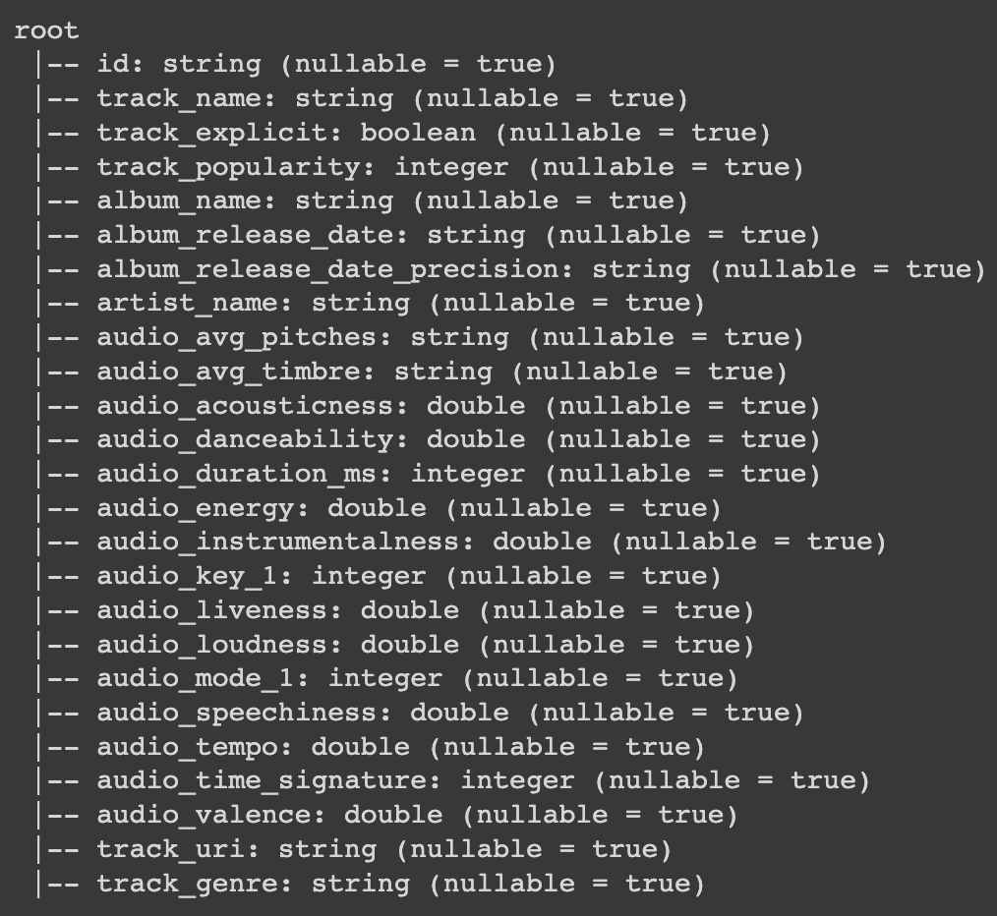
Description of the Dataset
Before the pre processing operations our dataset is composed by:
around 80k rows;
each row is described by 25 columns (features).
The preprocessing operations we did to the dataset led these numbers to grow significantly, reaching 100k rows and each row is described by 47 features.

Slide 7
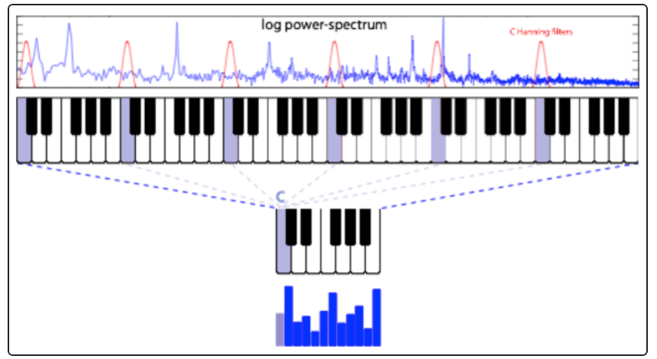
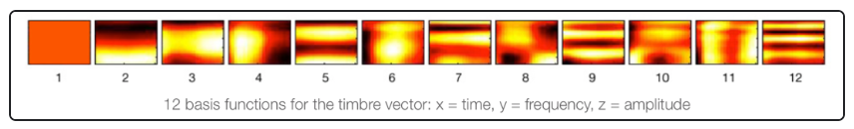
Feature Variety
Combined Spotify audio features and audio analysis (e.g. audio_acousticness, audio_danceability, audio_energy, etc.).
Averaged pitch and timbre vectors over all song segments.
Included miscellaneous metrics (popularity, date of release, etc.).

Slide 8
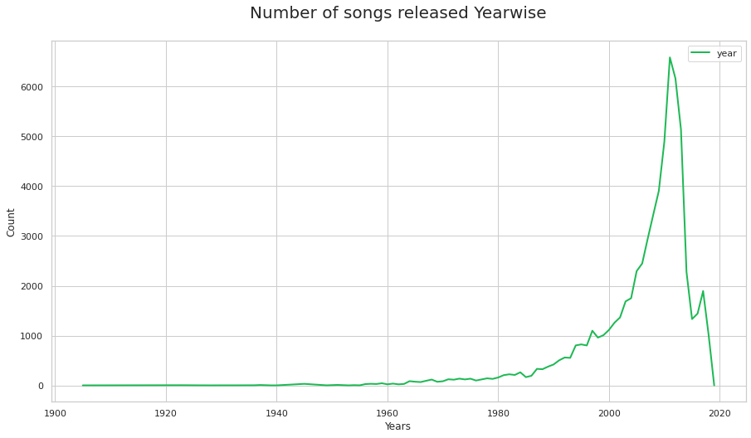
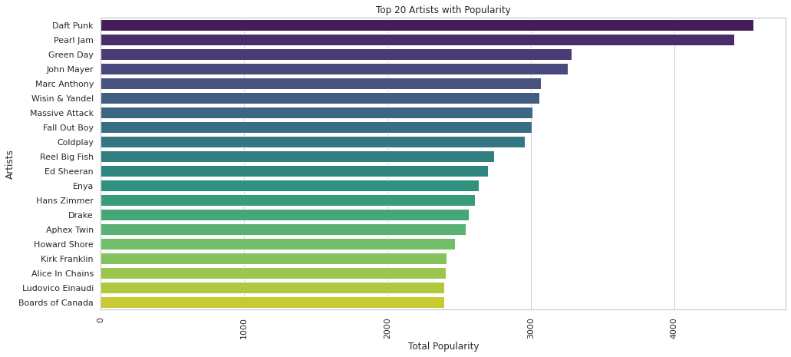
Data Exploration
In our project we decided to “explore” our dataset and we have shown some graphs including:
Visualization of variability of some features
Correlation Map
Most Popular Tracks
Most Popular Artists
Most present Artist
Number of songs released year wise
Year VS Popularity
Danceability vs Popularity
Key vs Popularity
Key vs Genre

Slide 9
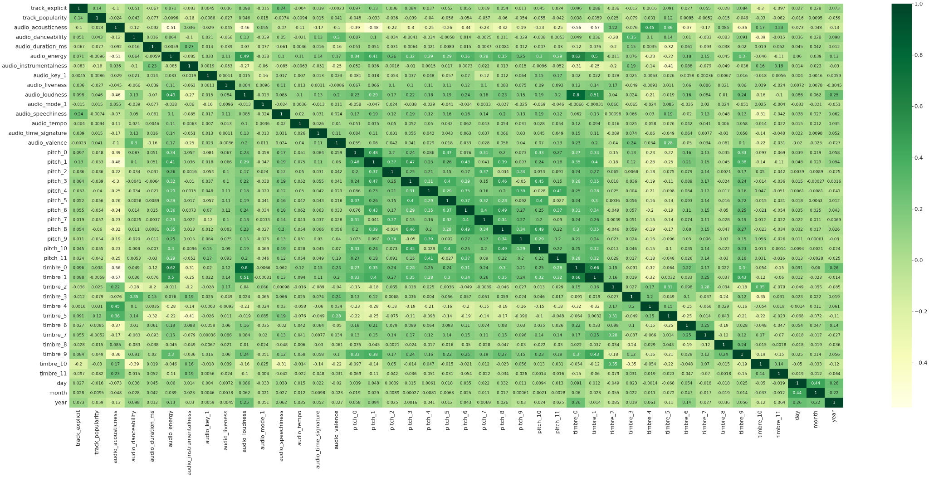
Data Exploration - Correlation Map

Slide 10
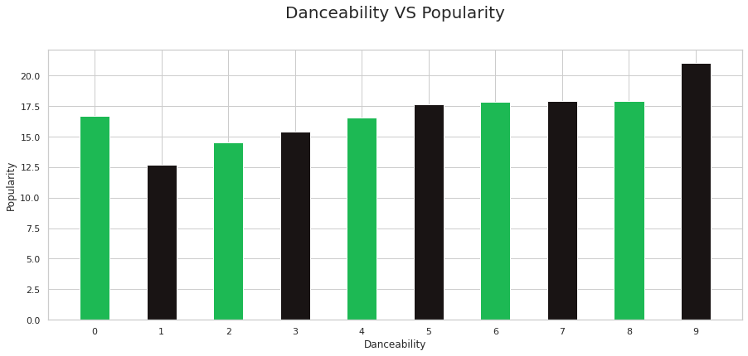
Data Exploration

Slide 11
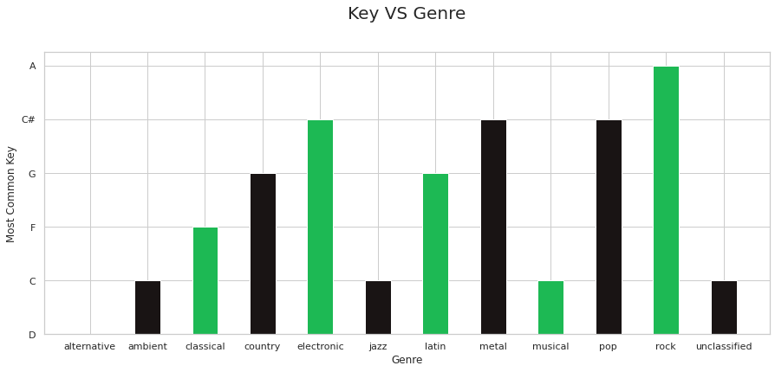
Data Exploration

Slide 12
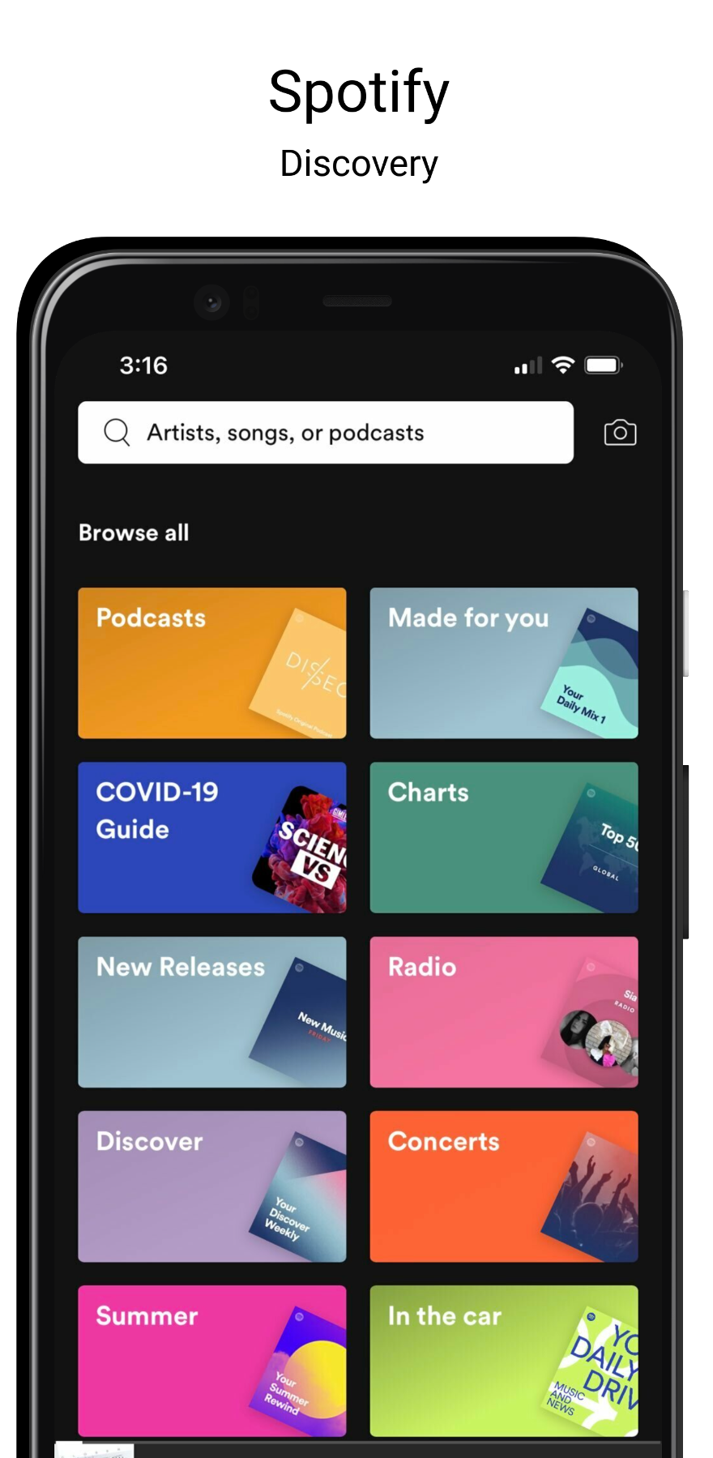
Discretization: Spotify Genre
According to Spotify there are 126 genres for the tracks, so we decided to group them into 12 “big-genres” into a json file to simplify the classification.
In this way we did a mapping for the genre by looking at some documentation on the web to see if a particular genre was part of a "main" genre (eg j-rock is part of the rock genre category).

Slide 13
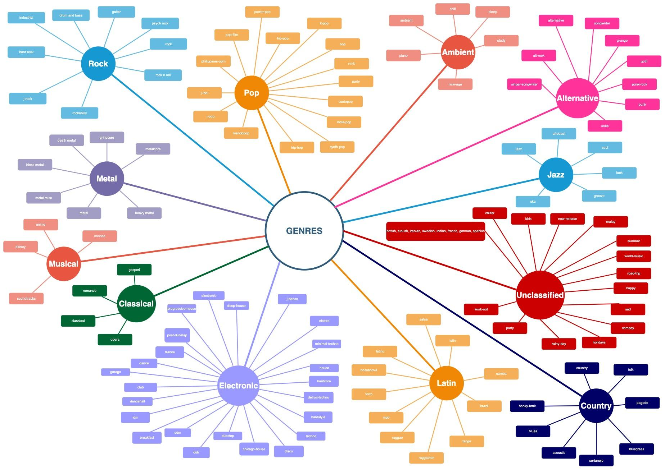

Slide 14
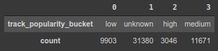
Discretization: Spotify Popularity
According to Spotify’s Web API the popularity of a track is ranked with a number between 1 and 100.
We decided to discretize our target in 10 classes (0-9) and then we gave a label to each class according to this role:
0 == popularity: unknown label
0 < popularity <= 2: low label
2 < popularity <= 5: medium label
5 < popularity <= 9: high label
We use Bucketizer to “discretize” our target feature “track_popularity”:

Slide 15
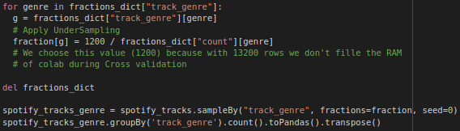
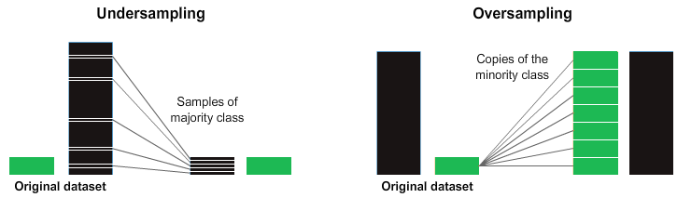
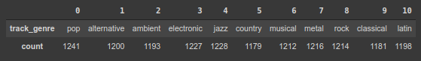
Balancement
In the project we decided to balance the dataset and create one for genre and one for popularity.
We decided to apply random sample to undersampling the datasets for two reasons:
get around memory-related problems while running (during cross validation).
many algorithms suffer if the classes are not balanced, if we have two classes, call it class A and class B if class A represents 90% of the dataset an algorithm can completely ignore the minority class (class B).

Slide 16
Encoding Pipeline
This step is not always mandatory (e.g., decision trees are able to work nicely with categorical features without the need of transforming them to numerical). Still, other methods (like logistic regression) are designed to operate with numerical inputs only.
To transform categorical features into numerical ones we proceed as follows. We setup a pipeline which is composed of the following steps:
Label Encode target feature
Label Encode categorical feature
Vector Assembler
Standard Scaler

Slide 17
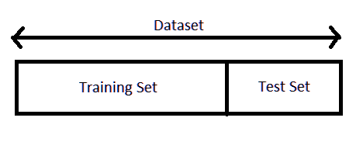
Split the dataset
We split our dataset into 2 portions:
training set (e.g., accounting for 80% of the total number of instances);
test set (e.g., accounting for the remaining 20% of instances)

Slide 18
Supervised Learning: Classification
In our project we decided to test the following models:
Decision Tree Classifier.
Logistic Regression.
Random Forest Classifier.
Multi Layer Perceptron Network.
We have decided to separate the Training from the Pipeline for time and memory reasons in order to run each model independently.

Slide 19
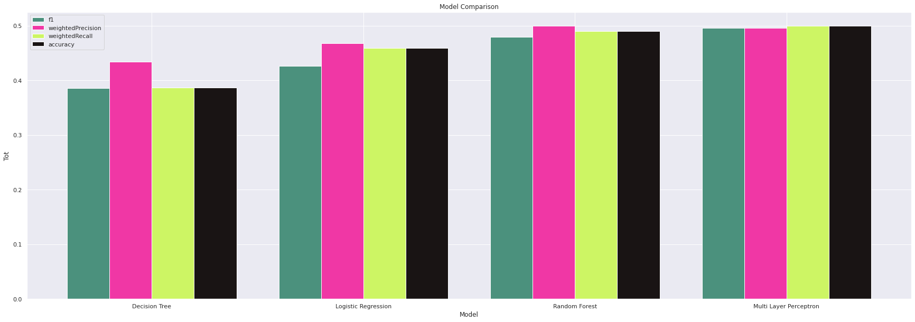
Model Comparison: Music genre classification with Cross Validation

Slide 20
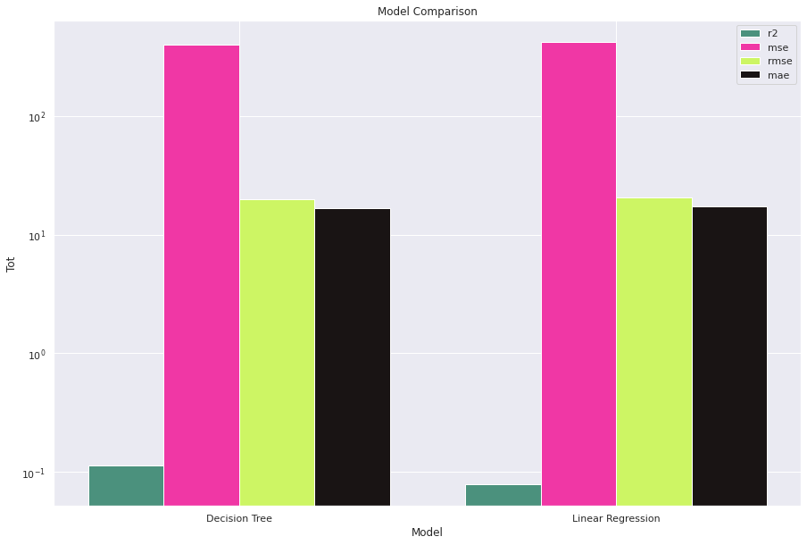
Model Comparison: Popularity regression with Cross Validation

Slide 21
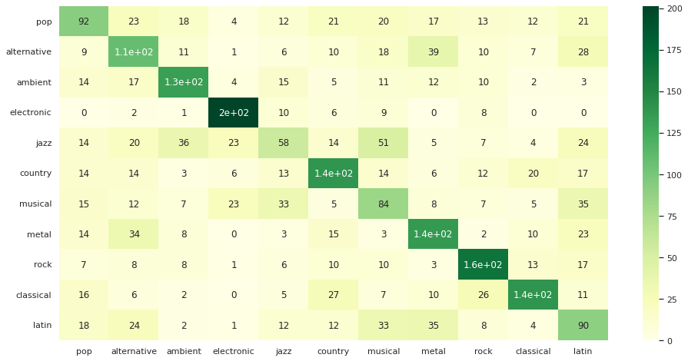
Confusion Matrix: MLP Genre

Slide 22
Weakness of the Classifier
Genre:
to make the problem easier we have reduced the number of target classes;
this was done manually by looking at the historical / social influences between the various genres;
this is not a reliable method, as it is subject to human errors, moreover a track can have influences from several different genres.
Popularity:
Spotify for many tracks does not rank popularity (default 0) → the result is an unbalanced dataset
In addition, the songs with high popularity (> 70) are in a much lower percentage than the others.

Slide 23
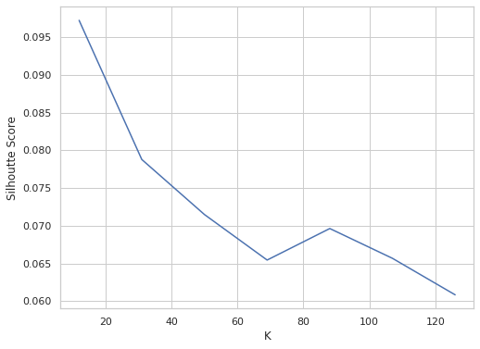
Unsupervised Learning:
K-Means Clustering
We decided to train k-means clustering algorithm by setting the number of clusters (k) equals to 12, that represents the “big-genres”.
We used the following parameters:
distance measure: cosine similarity
metric measure: silhouette
To evaluate k-means we print the silhouette score in order to find a local maxima.

Slide 24

Recommender System
The idea is to recommend songs to the user, to be included in their own playlist.
Problem:
Spotify Web Api does not provide data on other users
It is possible to obtain a user's playlist only if they are public and if you know their Spotify ID in advance.
For these reasons we have chosen Content-based filtering to develop this system.
The algorithm can be divided into two steps:
Creating the summary vector;
Find the similarity and suggest the songs.

Slide 25
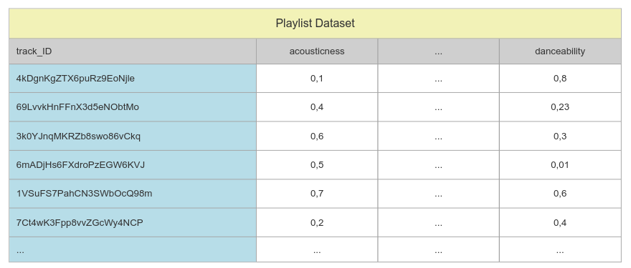
Recommender System: Summary Vector
Summarize by adding all the songs in a playlist into a vector that can be compared to the main dataset to find their similarities.

Slide 26
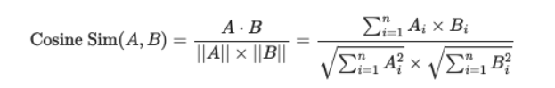
Recommender System: Similarity
We use cosine similarity to calculate the similarity between the summary vector and each song of the main dataset (not including the songs in the playlist).
Once the similarity has been calculated, we add it as a new column to the dataset, and then sort it in descending order and select the first 50 songs to recommend.

Slide 27


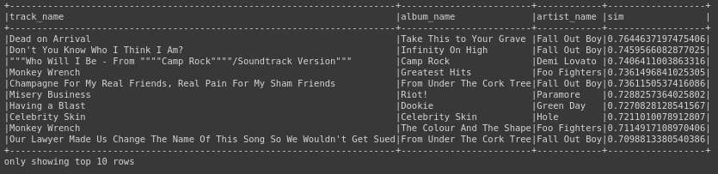
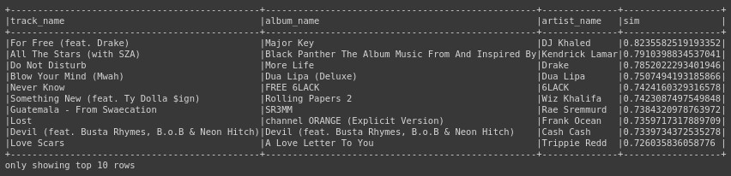
Recommender System
Advantage:
the temporal complexity, as it is equivalent to a multiplication between matrices.
Problem:
there are no metrics to evaluate whether the recommendation is good or bad.

